Slide 1
CS3006 Parallel and Distributed Computing
Fall 2022
National University of Computer and Emerging Sciences

Slide 2
The Hadoop Distributed File System

Slide 3
HADOOP
A collection of open-source software utilities that facilitates using a network of many computers to solve problems involving massive amounts of data and computation
It provides a software framework for distributed storage and processing of big data using the MapReduce programming model.
The core of Apache Hadoop consists of a storage part, known as Hadoop Distributed File System (HDFS), and a processing part which is a MapReduce programming model.
Hadoop splits files into large blocks and distributes them across nodes in a cluster.
Notes:
Hadoop vs SuperCopmputers

Slide 4
HADOOP
It then transfers packaged code into nodes to process the data in parallel
This approach takes advantage of data locality, where nodes manipulate the data they have access to.
This allows the dataset to be processed faster and more efficiently than it would be in a more conventional supercomputer architecture that relies on a parallel file system where computation and data are distributed via high-speed networking

Slide 5
HDFS
The Hadoop Distributed File System (HDFS) is the file system component of Hadoop.
It is designed to store very large data sets
reliably, and to stream those data sets
at high bandwidth to user applications.
These are achieved by replicating file content on multiple machines (DataNodes).

Slide 6
HDFS: Architecture
HDFS is a block-structured file system: Files broken into blocks of 128MB (per-file configurable).
A file can be made of several blocks, and they are stored across a cluster of one or more machines with data storage capacity.
Each block of a file is replicated across a number of machines, To prevent loss of data.

Slide 7
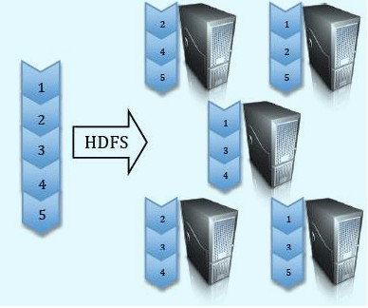

Slide 8
NameNode and DataNodes
HDFS stores file system metadata and application data separately.
Metadata refers to file metadata(attributes such as permissions, modification, access times, namespace and disk space quotas.
HDFS stores metadata on a dedicated server, called the NameNode.(Master)
Application data are stored on other servers called DataNodes.(Slaves)
All servers are fully connected and communicate with each other using TCP-based protocols.(RPC)
Notes:
Remote Procedure Call is a software communication protocol that one program can use to request a service from a program located in another computer

Slide 9
NameNode
Name Node maintain the namespace tree(a hierarchy of files and directories) operations like opening, closing, and renaming files and directories.
Determine the mapping of file blocks to DataNodes (the physical location of file data).
File metadata (i.e. “inode”) .
Authorization and authentication.
Collect block reports from Datanodes on block locations.
Replicate missing blocks.
HDFS keeps the entire namespace in RAM, allowing fast access to the metadata

Slide 10
DataNode
The DataNodes are responsible for serving read and write requests from the file system’s clients.
The DataNodes also perform block creation, deletion, and replication upon instruction from the NameNode.
Data nodes periodically send block reports to Namenode.

Slide 11
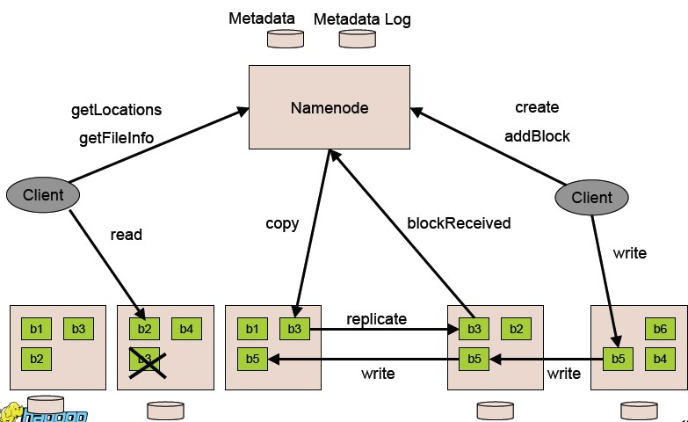

Slide 12
NameNode and DataNode communication: Heartbeats.
DataNodes send heartbeats to the NameNode to confirm that the DataNode is operating and the block replicas it hosts are available

Slide 13
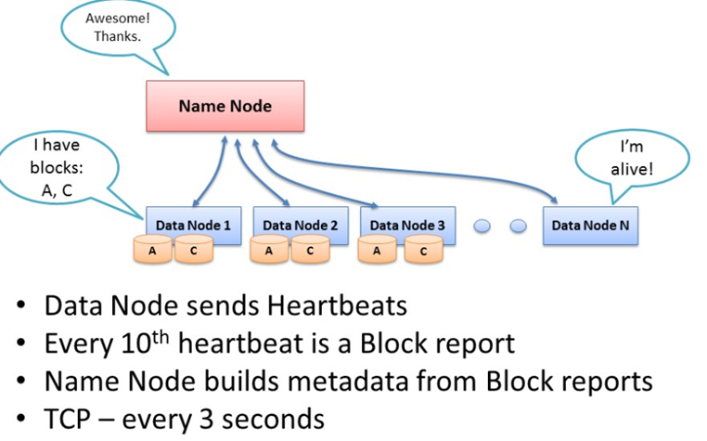

Slide 14
The NameNode does not directly call DataNodes. It uses replies to heartbeats to send instructions to the DataNodes. The instructions include commands to:
replicate blocks to other nodes;
remove local block replicas;
re-register or to shut down the node;
send an immediate block report.

Slide 15
Block Reports
A DataNode identifies block replicas in its possession to the NameNode by sending a block report.
A block report contains the block id, the generation stamp and the length for each block replica the server hosts.
Blockreports provide the NameNode with an up-to-date view of where block replicas are located on the cluster and nameNode constructs and maintains latest metadata from blockreports.

Slide 16
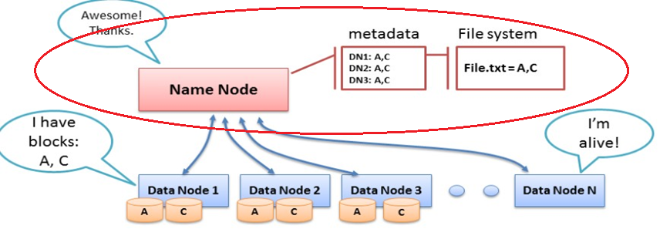

Slide 17
Failure Recovery
The NameNode does not directly call DataNodes. It uses replies to heartbeats to send instructions to the DataNodes.
The instructions include commands to:
replicate blocks to other nodes
remove local block replicas
re-register or to shut down the node
So when dataNode dies, NameNode will notice and instruct other dataNode to replicate data.

Slide 18
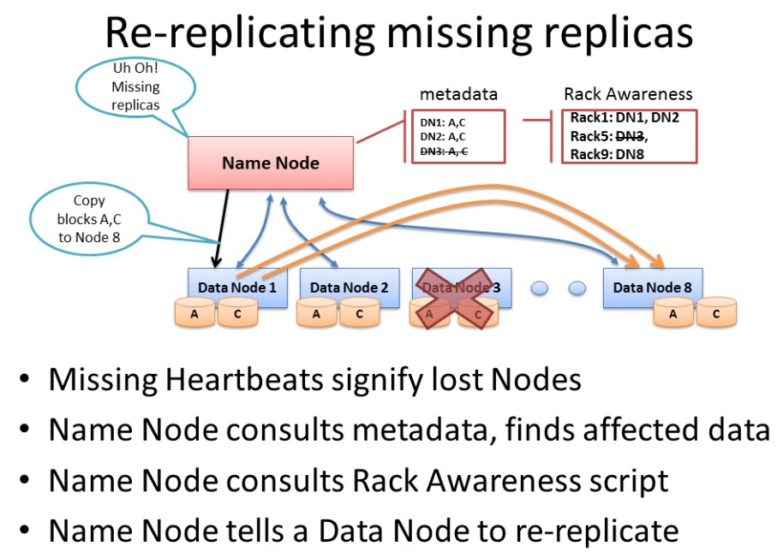

Slide 19
Failure Recovery
What if NameNode dies?
Keep journal (the modification log of metadata).
Checkpoint: The persistent record of the metadata stored in the local host’s native files system.
For example:
During restart, the NameNode initializes the namespace image from the checkpoint, and then replays changes from the journal until the image is up-to-date with the last state of the file system.

Slide 20
Failure Recovery
CheckpointNode and BackupNode: two other roles of NameNode
CheckpointNode:
When journal becomes too long, checkpointNode combines the existing checkpoint and journal to create a new checkpoint and an empty journal.
The CheckpointNode usually runs on a different host from the NameNode since it has the same memory requirements as the NameNode. It downloads the current checkpoint and journal files from the NameNode, merges them locally, and returns the new checkpoint back to the NameNode

Slide 21
Failure Recovery
BackupNode: A read-only NameNode
it maintains an in-memory, up-to-date image of the file system namespace that is always synchronized with the state of the NameNode.
If the NameNode fails, the BackupNode’s image in memory and the checkpoint on disk is a record of the latest namespace state

Slide 22
Failure Recovery
Upgrades and File System Snapshots
The purpose of creating snapshots in HDFS is to minimize potential damage to the data stored in the system during upgrades.
During software upgrades the possibility of corrupting the system due to software bugs or human mistakes increases.
The snapshot mechanism lets administrators persistently save the current state of the file system(both data and metadata), so that if the upgrade results in data loss or corruption, it is possible to rollback the upgrade and return HDFS to the namespace and storage state as they were at the time of the snapshot

Slide 23
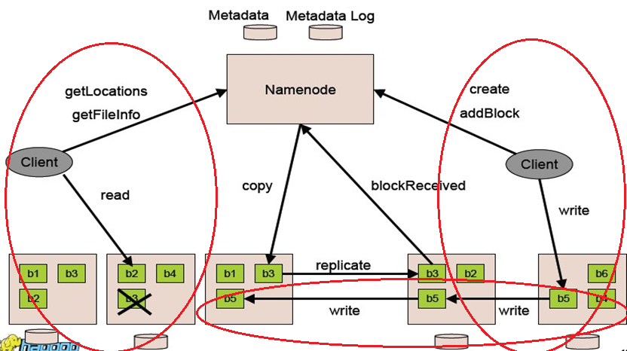
File I/O and Replica Management

Slide 24
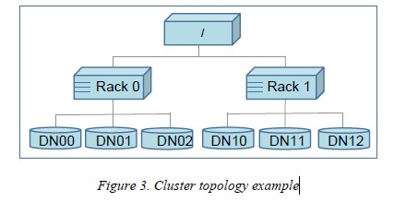
File I/O and Replica Management
Hadoop has the concept of “Rack Awareness”
For a large cluster, it may not be practical to connect all nodes in a flat topology
A common practice is to spread the nodes across multiple racks
Nodes of a rack share a switch, and rack switches are connected by one or more core switches.
Communication between two nodes in different racks has to go through multiple switches.

Slide 25
Rack Awareness in Hadoop is the concept to choose a nearby data node (closest to the client which has raised the Read/Write request), thereby reducing the network traffic

Slide 26
File I/O and Replica Management
The default HDFS replica placement policy can be summarized as follows:
No Datanode contains more than one replica of any block.
No rack contains more than two replicas of the same block, provided there are sufficient racks on the cluster

Slide 27
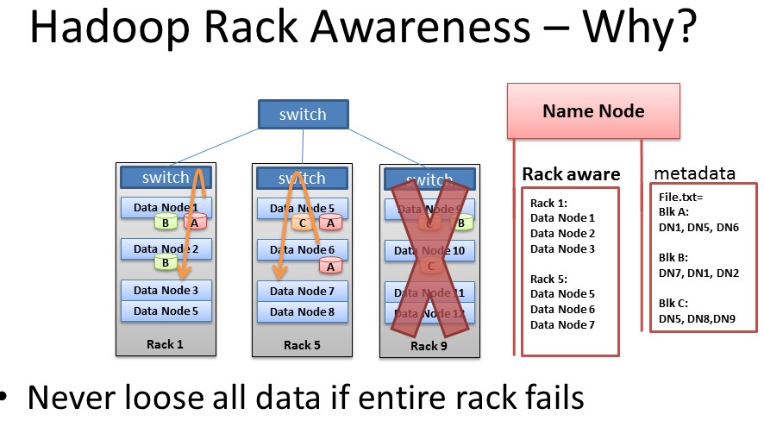

Slide 28
When there is a need for a new block, the NameNode allocates a block with a unique block ID and determines a list of DataNodes to host replicas of the block.
The DataNodes form a pipeline, the order of which minimizes the total network distance from the client to the last DataNode

Slide 29
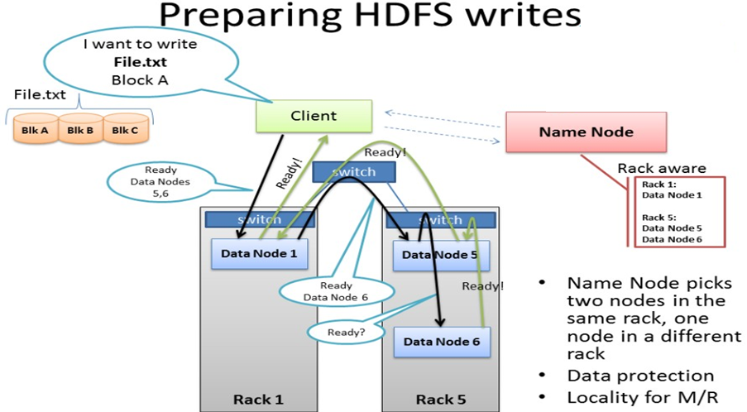
OK. Write to dataNode 1.
dsHey,DN1, duplicate Block A to DN5 and DN6.
Notes:
1. When there is a need for a new block, the NameNode allocates a block with a unique block ID and determines a list of DataNodes to host replicas of the block.
2. The DataNodes form a pipeline, the order of which minimizes the total network distance from the client to the last DataNode.

Slide 30
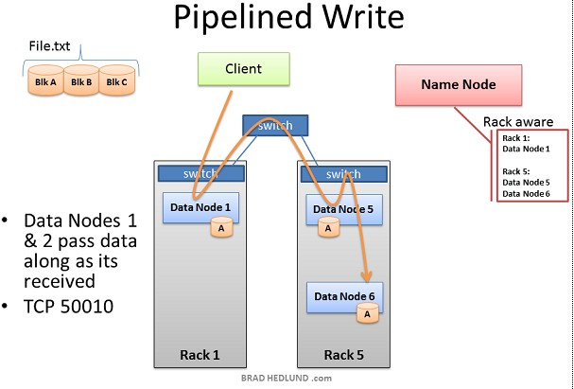

Slide 31
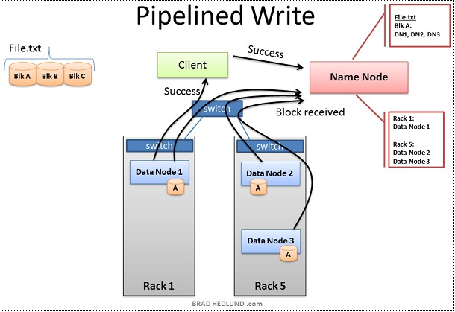

Slide 32
The more blocks that make up a file, the more machines the data can potentially spread
The more CPU cores and disk drives that have a piece of my data mean more parallel processing power and faster results
This is the motivation behind building large, wide clusters. To process more data, faster.

Slide 33
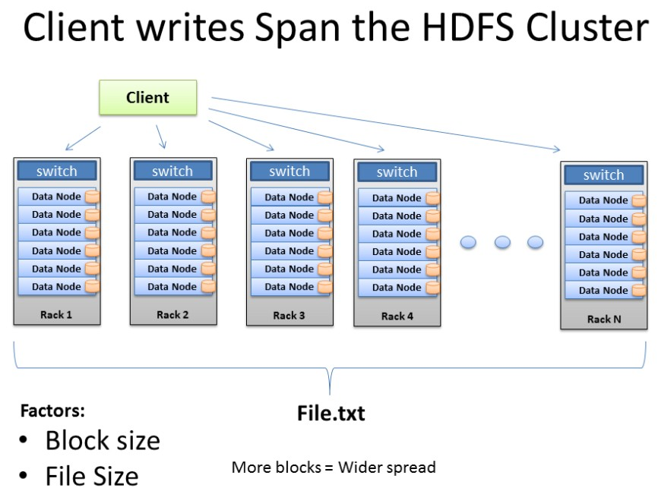

Slide 34
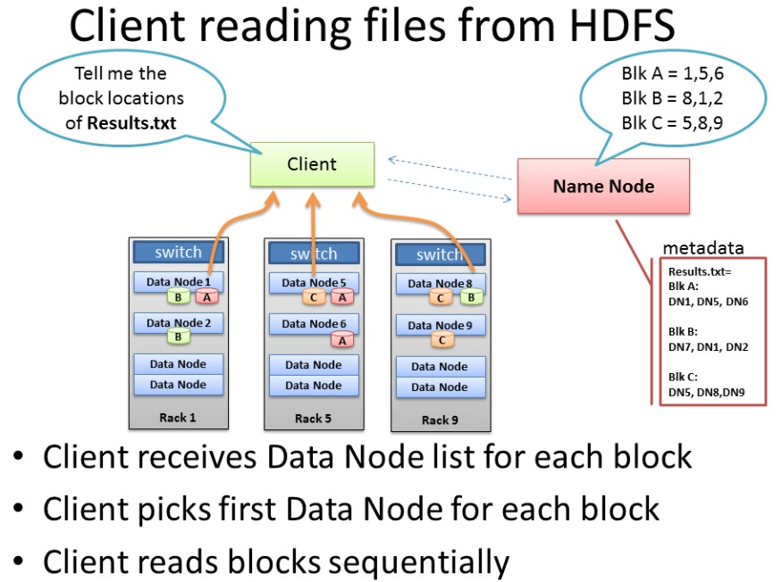
Client Reading Files from HDFS
Notes:
Client just fetches the first of the block choices NameNode provided,(1,8,5) actually fetched in the order of the distance from the client

Slide 35
Unbalanced Cluster
When we add new racks full of servers and network to an existing Hadoop cluster we can end up in a situation where our cluster is unbalanced.
In this case, Racks 1 & 2 were my existing racks containing File.txt and running my Map Reduce jobs on that data.
When I added two new racks to the cluster, my File.txt data doesn’t automatically start spreading over to the new racks. All the data stays where it is.
The new servers are sitting idle with no data, until I start loading new data into the cluster.
Furthermore, if the servers in Racks 1 & 2 are really busy, the Job Tracker may have no other choice but to assign Map tasks on File.txt to the new servers which have no local data
The new servers need to go grab the data over the network. As as result you may see more network traffic and slower job completion times.

Slide 36
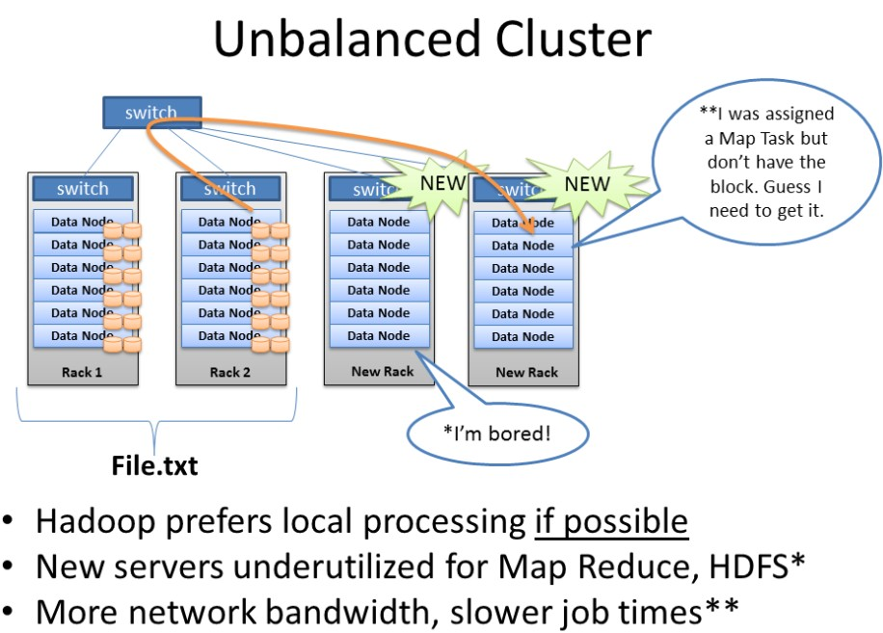

Slide 37
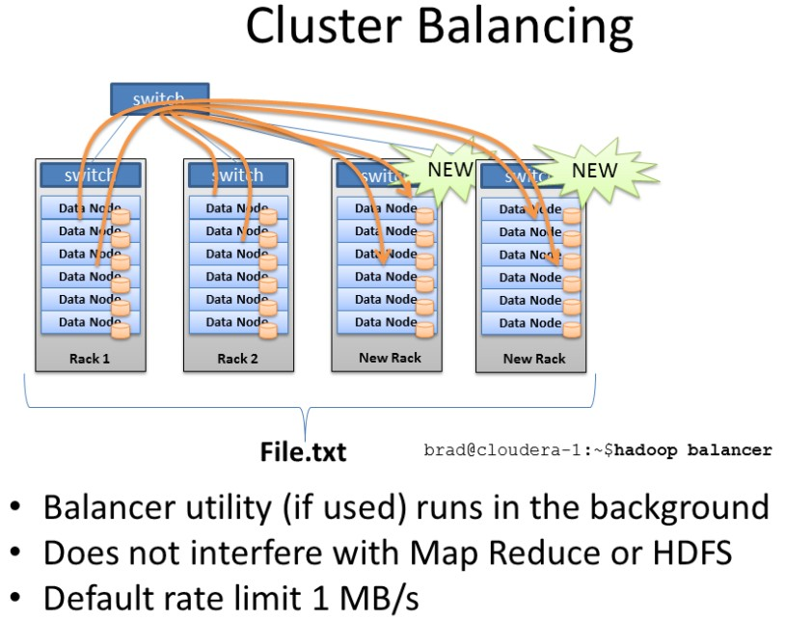
Balancer

Slide 38
Balancer
Balancer looks at the difference in available storage between nodes and attempts to provide balance to a certain threshold.
New nodes with lots of free disk space will be detected and balancer can begin copying block data off nodes with less available space to the new nodes.

Slide 39
Practice at Yahooo
70 percent of the disk space is allocated to HDFS. The remainder is reserved for the operating system (Red Hat Linux), logs, and space to spill the output of map tasks. (MapReduce intermediate data are not stored in HDFS.)
For each cluster, the NameNode and the BackupNode hosts are specially provisioned with up to 64GB RAM; application tasks are never assigned to those hosts.
In total, a cluster of 3500 nodes has 9.8 PB of storage available as blocks that are replicated three times yielding a net 3.3 PB of storage for user applications. As a convenient approximation, one thousand nodes represent one PB of application storage.
Notes:
Why MapReduce intermediate data are not stored in HDFS?
HDFS read and write is expensive.
2. If intermediate data is lost, computation can be done on the corresponding dataNode again to get intermediate data. It is determinstic.

Slide 40
Practice at Yahoo
Durability of Data
uncorrelated node failures
Replication of data three times is a robust guard against loss of data due to uncorrelated node failures.
correlated node failures, the failure of a rack or core switch.
HDFS can tolerate losing a rack switch (each block has a replica on some other rack).
loss of electrical power to the cluster
a large cluster will lose a handful of blocks during a power-on restart.

Slide 41
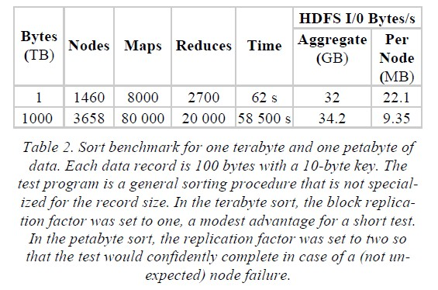
Benchmarks
Notes:
For row two, failure is no long uncommon, because, for example, if one machine dies in a thousand machines, when ten thousand machines, ten machines may die. This is a lot. So replica factor being two is necessary.

